Slide 2
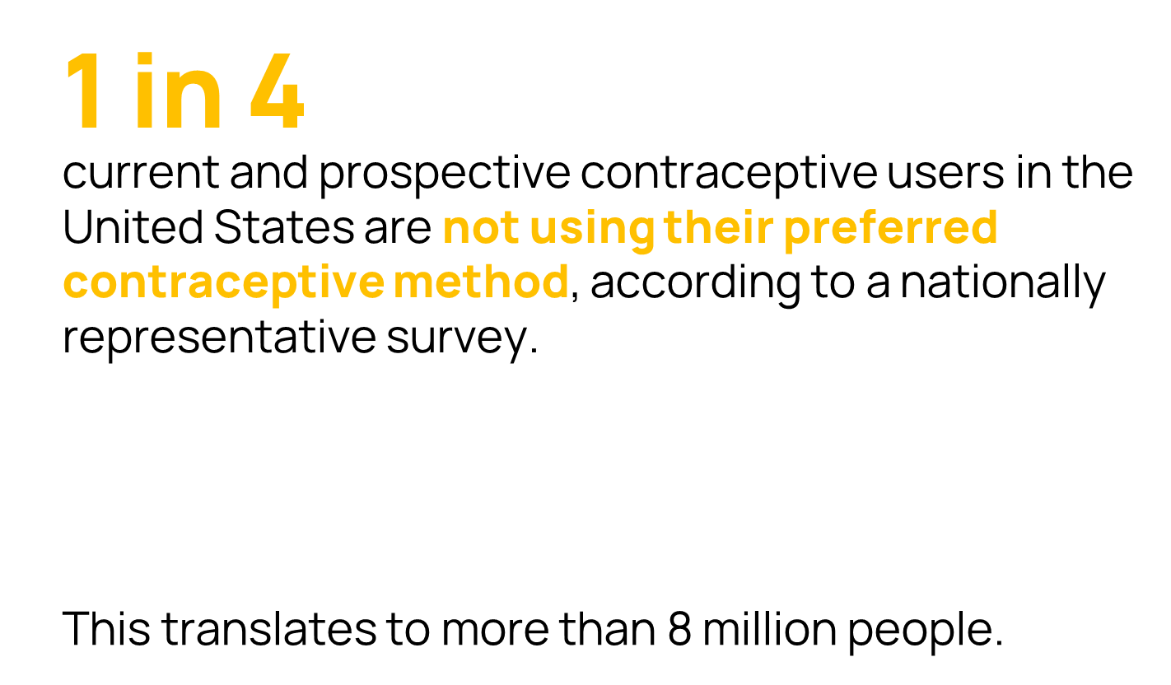
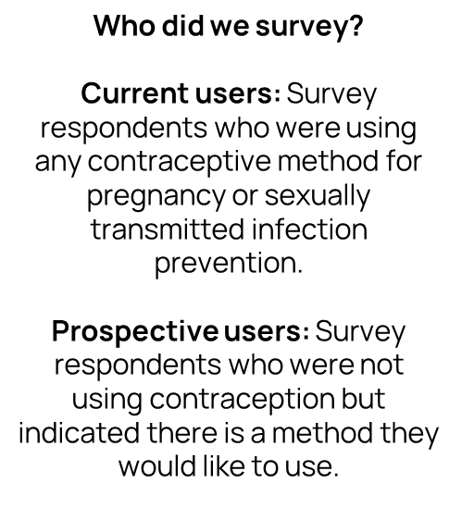
Gómez AM, Bennett AH, Arcara J, Stern L, Bardwell J, Cadena D, Chaudhri A, Davis L, Dehlendorf C, Frederiksen B, Labiran C, McDonald-Mosley, Rice WS, Stein T, Valladares ES, Kavanaugh M, Marshall C. (2024). “Estimates of Use of Preferred Contraceptive Method in the United States: A Population-Based Study.” Lancet Regional Health-Americas 30(100662). https://doi.org/10.1016/j.lana.2023.100662

Slide 3
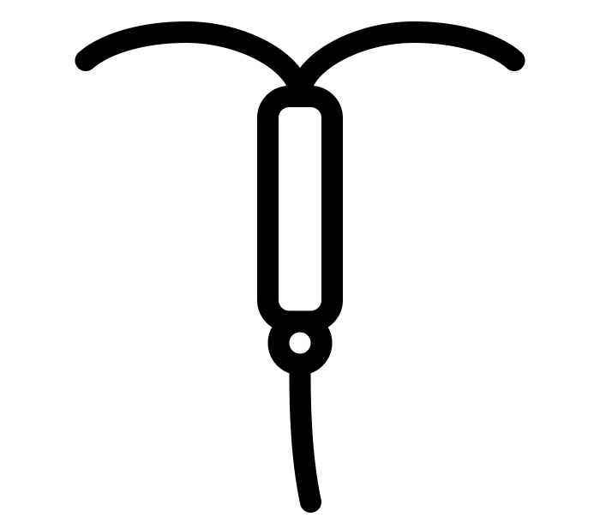
Gómez AM, Bennett AH, Arcara J, Stern L, Bardwell J, Cadena D, Chaudhri A, Davis L, Dehlendorf C, Frederiksen B, Labiran C, McDonald-Mosley, Rice WS, Stein T, Valladares ES, Kavanaugh M, Marshall C. (2024). “Estimates of Use of Preferred Contraceptive Method in the United States: A Population-Based Study.” Lancet Regional Health-Americas 30(100662). https://doi.org/10.1016/j.lana.2023.100662

Slide 4
Gómez AM, Bennett AH, Arcara J, Stern L, Bardwell J, Cadena D, Chaudhri A, Davis L, Dehlendorf C, Frederiksen B, Labiran C, McDonald-Mosley, Rice WS, Stein T, Valladares ES, Kavanaugh M, Marshall C. (2024). “Estimates of Use of Preferred Contraceptive Method in the United States: A Population-Based Study.” Lancet Regional Health-Americas 30(100662). https://doi.org/10.1016/j.lana.2023.100662

Slide 5
Have received person-centered contraceptive counseling*
Gómez AM, Bennett AH, Arcara J, Stern L, Bardwell J, Cadena D, Chaudhri A, Davis L, Dehlendorf C, Frederiksen B, Labiran C, McDonald-Mosley, Rice WS, Stein T, Valladares ES, Kavanaugh M, Marshall C. (2024). “Estimates of Use of Preferred Contraceptive Method in the United States: A Population-Based Study.” Lancet Regional Health-Americas 30(100662). https://doi.org/10.1016/j.lana.2023.100662

Slide 6
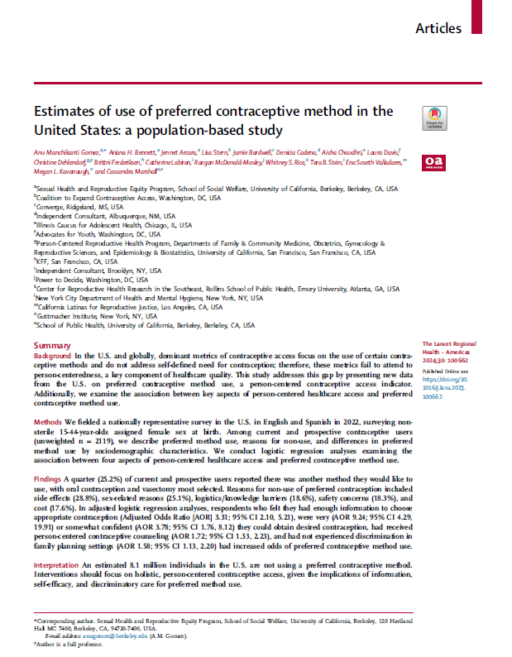
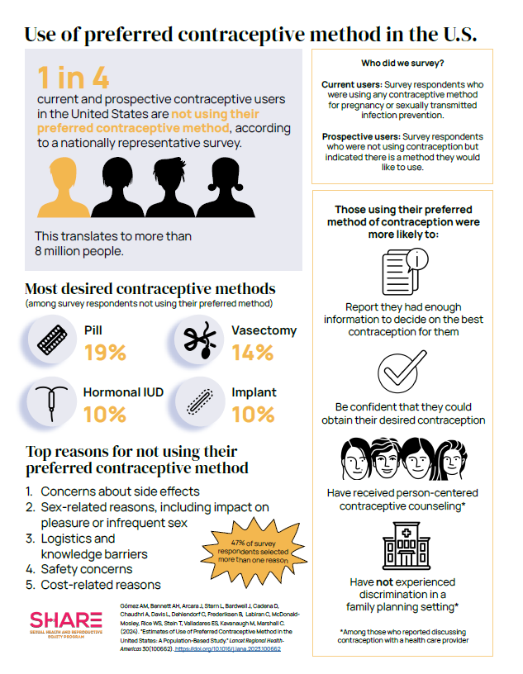
Read the full paper:
Gómez AM, Bennett AH, Arcara J, Stern L, Bardwell J, Cadena D, Chaudhri A, Davis L, Dehlendorf C, Frederiksen B, Labiran C, McDonald-Mosley, Rice WS, Stein T, Valladares ES, Kavanaugh M, Marshall C. (2024). “Estimates of Use of Preferred Contraceptive Method in the United States: A Population-Based Study.” Lancet Regional Health-Americas 30(100662). https://doi.org/10.1016/j.lana.2023.100662
For more information, visit:
https://www.share.berkeley.edu/person-centered-contraceptive-access
Click the image to view this presentation as a brief:

